Slide 1
Running a small business
Task A: Profit in percentages
1) Fill in the blanks for this small business’ first few years of results and comment on how their profit margin is changing.
 | Gross profit | Revenue | Gross profit margin
Year one | £0 | £12 000 | 0%
Year two | £1000 | £20 000
Year three |  | £48 000 | 12.5%
Year four | £20 000 |  | 40%
Year five | £24 500 | £56 000
2) Calculate the gross profit margin for each of these items for this new paddleboard shop.
a) 10 ft paddleboard: Selling price £575, cost price £373.75
b) 12 ft paddleboard: Selling price £650, cost price £390
c) Carbon paddle: Selling price £110, cost price £82.50
d) Buoyancy aid: Selling price £60, cost price £34.50
e) Comment on which product is not achieving their 30% gross profit margin target and advise on what they should do.

Slide 2
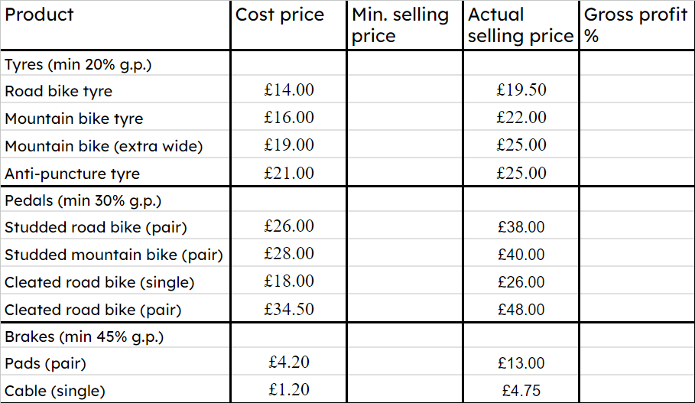
Running a small business
3) a) By completing a spreadsheet or otherwise, calculate the minimum selling price and gross profit margins for this bicycle shop’s products.
b) Comment on any products not achieving minimum gross profit margins.
c) Advise the business as to which products they should place most prominently in their shop.

Slide 3
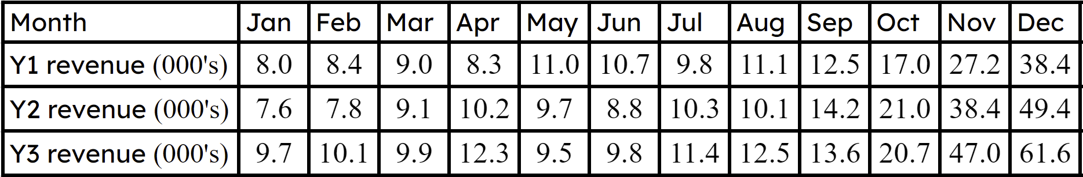
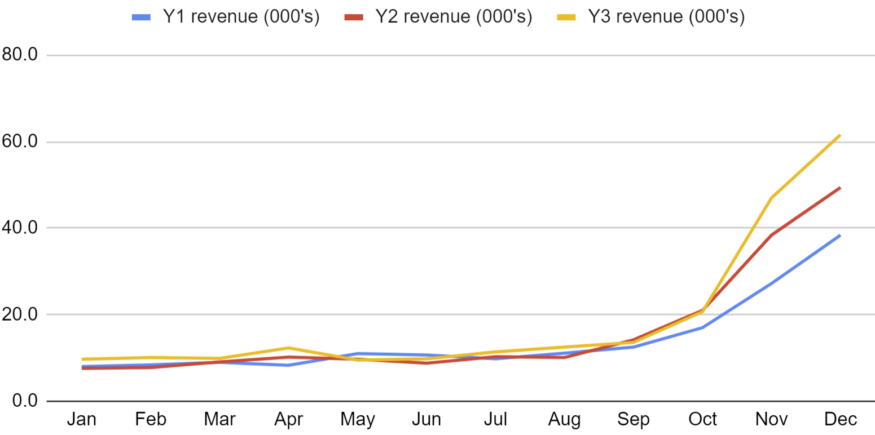
Running a small business
Task B: Tracking performance
1) Here are the first three years of sales for a new small business.
a) Calculate the mean and range for each year and comment on any changes year-on-year.
b) Comment on any patterns you spot in the data.
Mathematics in Education and Industry
v2.4

